Slide 1
A THESIS PRESENTATION ON
Implementation of Liver Segmentation from Computed Tomography (CT) Images using Deep Learning
Implementation of Liver Segmentation from Computed Tomography (CT) Images using Deep Learning
by
MD Ashraf Hossain Ifty (2017338042), and
Md. Salim Shahed Shajid (2017338016)
MD Ashraf Hossain Ifty, Md. Salim Shahed Shajid
Thesis group: 3
Supervised by
Dr. Md Rasedujjaman
Electrical and Electronic Engineering,
Shahjalal University of Science and Technology, Sylhet-3114, Bangladesh
Electrical and Electronic Engineering,
Shahjalal University of Science and Technology, Sylhet-3114, Bangladesh

Slide 2

OUTLINE
PROBLEM STATEMENT
Problem Statement
Research Objectives
Methodology
Data collection
DATA DESCRIPTION
DATA PREPARATION
DATA PRE-PROCESSING
TRAINING
overview
Parameter evaluation
results
CONCLUSIONS & Future work
PAPER ID: []
MD Ashraf Hossain Ifty, Md. Salim Shahed Shajid
Electrical and Electronic Engineering,
Shahjalal University of Science and Technology, Sylhet-3114, Bangladesh
Implementation of Liver Segmentation from Computed Tomography (CT) Images using Deep Learning

Slide 3
RESEARCH OBJECTIVES
PROBLEM STATEMENT
Liver segmentation from CT images is a crucial step in the automatic detection of liver disease, liver volume measurement, and 3D liver volume rendering.
The diagnosis and treatment of liver cancer depend heavily on the segmentation of the liver from CT images.
Manual segmentation of liver from CT images is a strenuous and time-consuming process, with results that vary depending on the expertise of the operator.
Automatic segmentation of the liver from CT images can address these challenges.
Implementation of Liver Segmentation from Computed Tomography (CT) Images using Deep Learning
Problem Statement
Research Objectives
Methodology
Data collection
preparing training data
Training
Results
Future work

Slide 4
METHODOLOGY
RESEARCH OBJECTIVES
PROBLEM STATEMENT
DATA COLLECTION
Bangladesh is a densely populated nation with a scarcity of trained radiologists, making the monitoring and diagnosis of illnesses from CT images increasingly riskier and more expensive.
The objective is to develop a quick, affordable, and reliable method of automatic liver segmentation that medical professionals in Bangladesh can employ.
The research uses a dataset of 131 contrast-enhanced abdomen CT scans and a deep learning model to automatically segment the liver.
The research compares the accuracy of the developed model with that of the liver tumor segmentation challenge dataset and demonstrates that the trained model can extract the liver from unseen CT images with great proficiency.
MD Ashraf Hossain Ifty, Md. Salim Shahed Shajid
Why are medical images important?
For Diagnosis and treatment of diseases
Medical images are difficult to analyze
Medical images are not typical image files
3d medicals images are mostly in nifti (.nii / .nii.gz) format
The nifty files contain 2d slices called Dicom (.dcm) files
Implementation of Liver Segmentation from Computed Tomography (CT) Images using Deep Learning

Slide 5
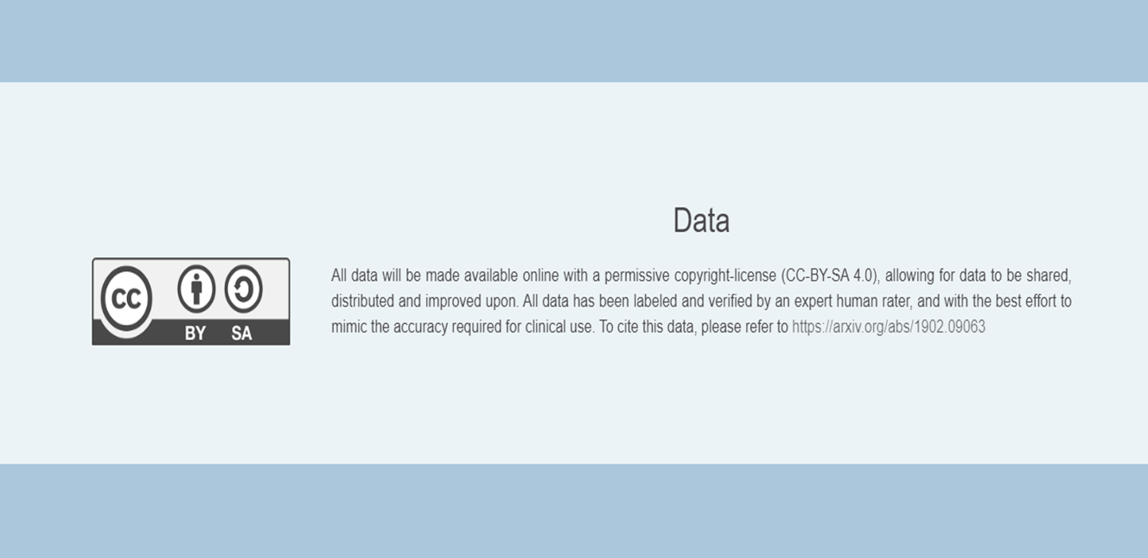
RESEARCH OBJECTIVES
METHODOLOGY
DATASET COLLECTION
DATASET DESCRIPTION
Why are medical images important?
For Diagnosis and treatment of diseases
Medical images are difficult to analyze
Medical images are not typical image files
3d medicals images are mostly in nifti (.nii / .nii.gz) format
The nifty files contain 2d slices called Dicom (.dcm) files
Introduction
image segmentation
the Deep learning Architecture
Monai framework
Methodology
Data collection
preparing training data
Training
results
7. Future work
DEEP LEARNING CAN HELP US ANALYSE THESE IMAGES AND MAKE PREDICTIONS
OUR GOAL IS TO TRAIN A DEEP LEARNING MODEL (U-NET) THAT ACCURATELY DETECTS ORGANS
The dataset was extracted from the Liver Tumor Segmentation Challenge (LiTS17)-LiTS.
The dataset was developed in association with seven hospitals and academic centers and was manually examined by three unbiased radiologists.
MD Ashraf Hossain Ifty, Md. Salim Shahed Shajid
Electrical and Electronic Engineering,
Shahjalal University of Science and Technology, Sylhet-3114, Bangladesh
Implementation of Liver Segmentation from Computed Tomography (CT) Images using Deep Learning

Slide 6
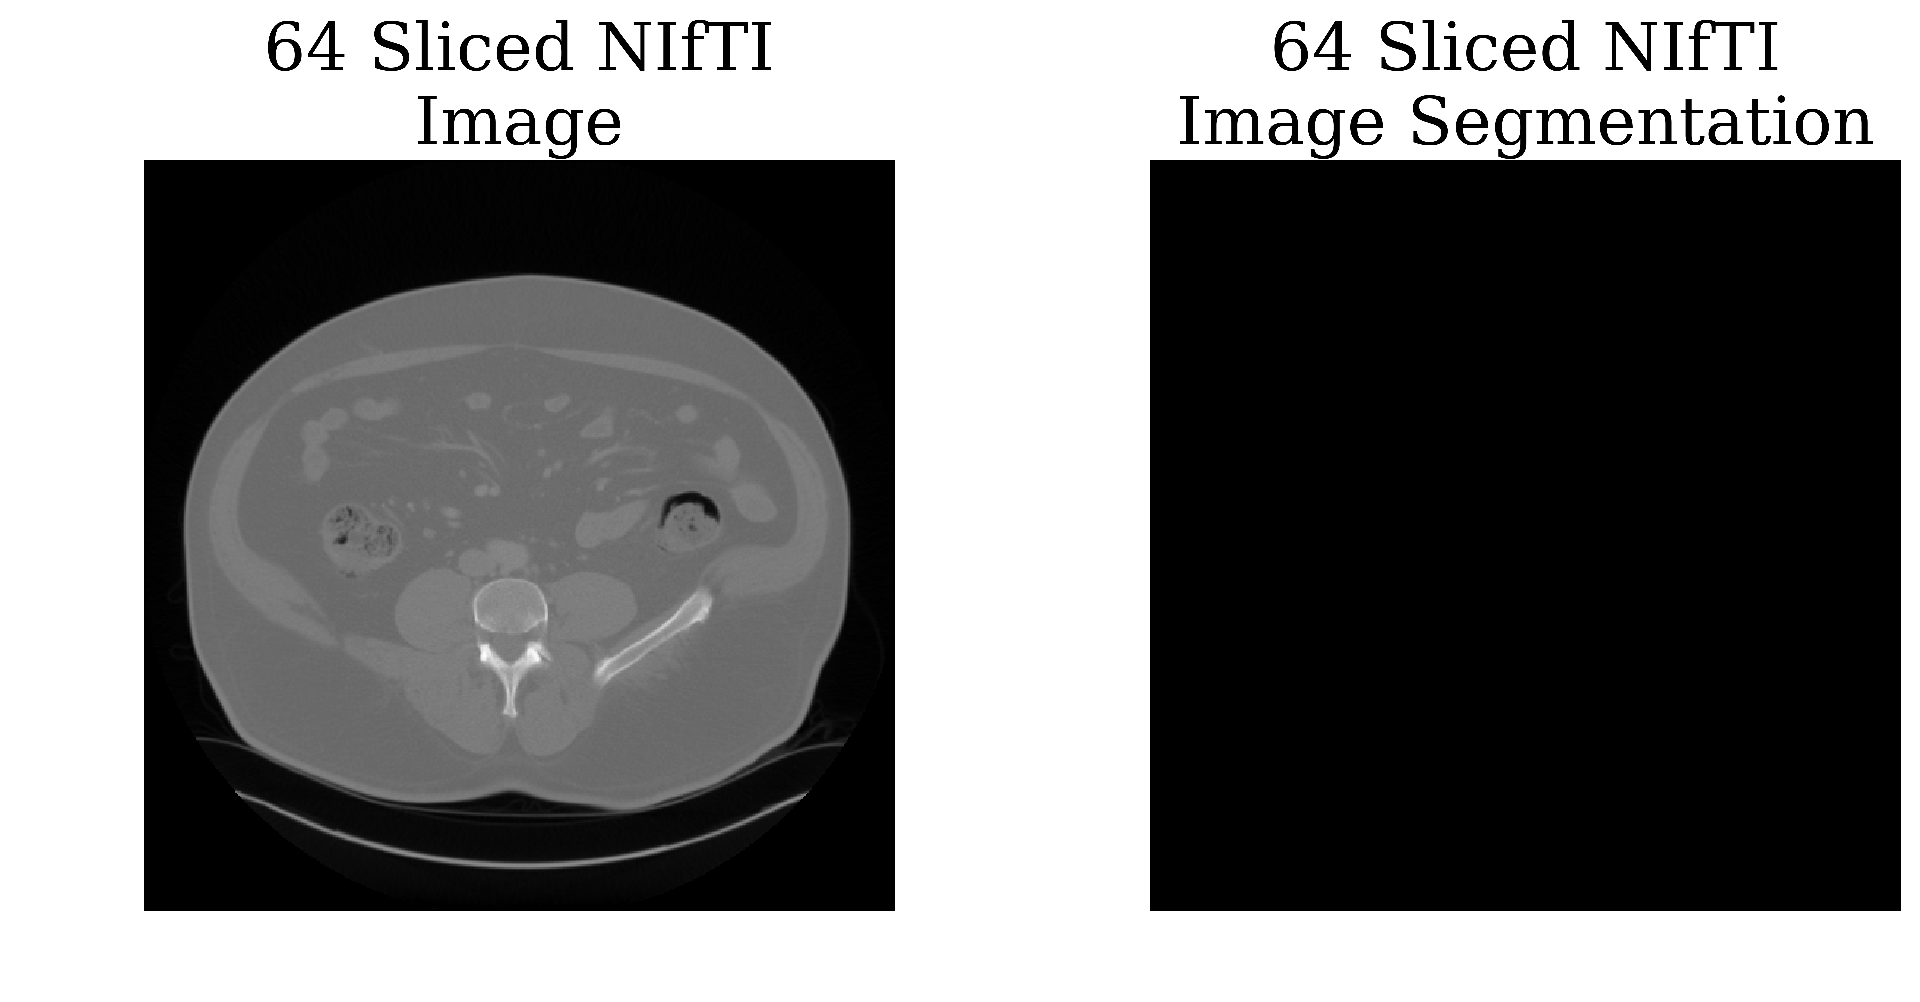
METHODOLOGY
PREPARING TRAINING DATA
DATASET COLLECTION
DATA PREPARATION
DATASET DESCRIPTION
The dataset contains 131 CT scans of the abdomen and corresponding liver segmentation masks.
The CT scans were acquired from various clinical facilities worldwide.
The individuals in the CT scans had primary and secondary liver metastases and malignancies.
Trained radiologists and oncologists manually annotated the data with two labels (liver and lesion).
The CT images and segmentation masks were in NifTI (.nii.gz) file format and had a minimum and maximum number of slices of 74 and 987, respectively, making the model robust to domain shift.
MEDICAL IMAGE CONTAINS HUNDREDS OF IMAGES SLICES
INDIVIDUAL MEDICAL IMAGE FILE WERE CONVERTED INTO MULTIPLE MEDICAL IMAGES
AFTER CONVERSION, ALL OF THE MEDICAL IMAGE CONTAIN 64 SLICES OF IMAGE.
Electrical and Electronic Engineering,
Shahjalal University of Science and Technology, Sylhet-3114, Bangladesh
Implementation of Liver Segmentation from Computed Tomography (CT) Images using Deep Learning

Slide 7
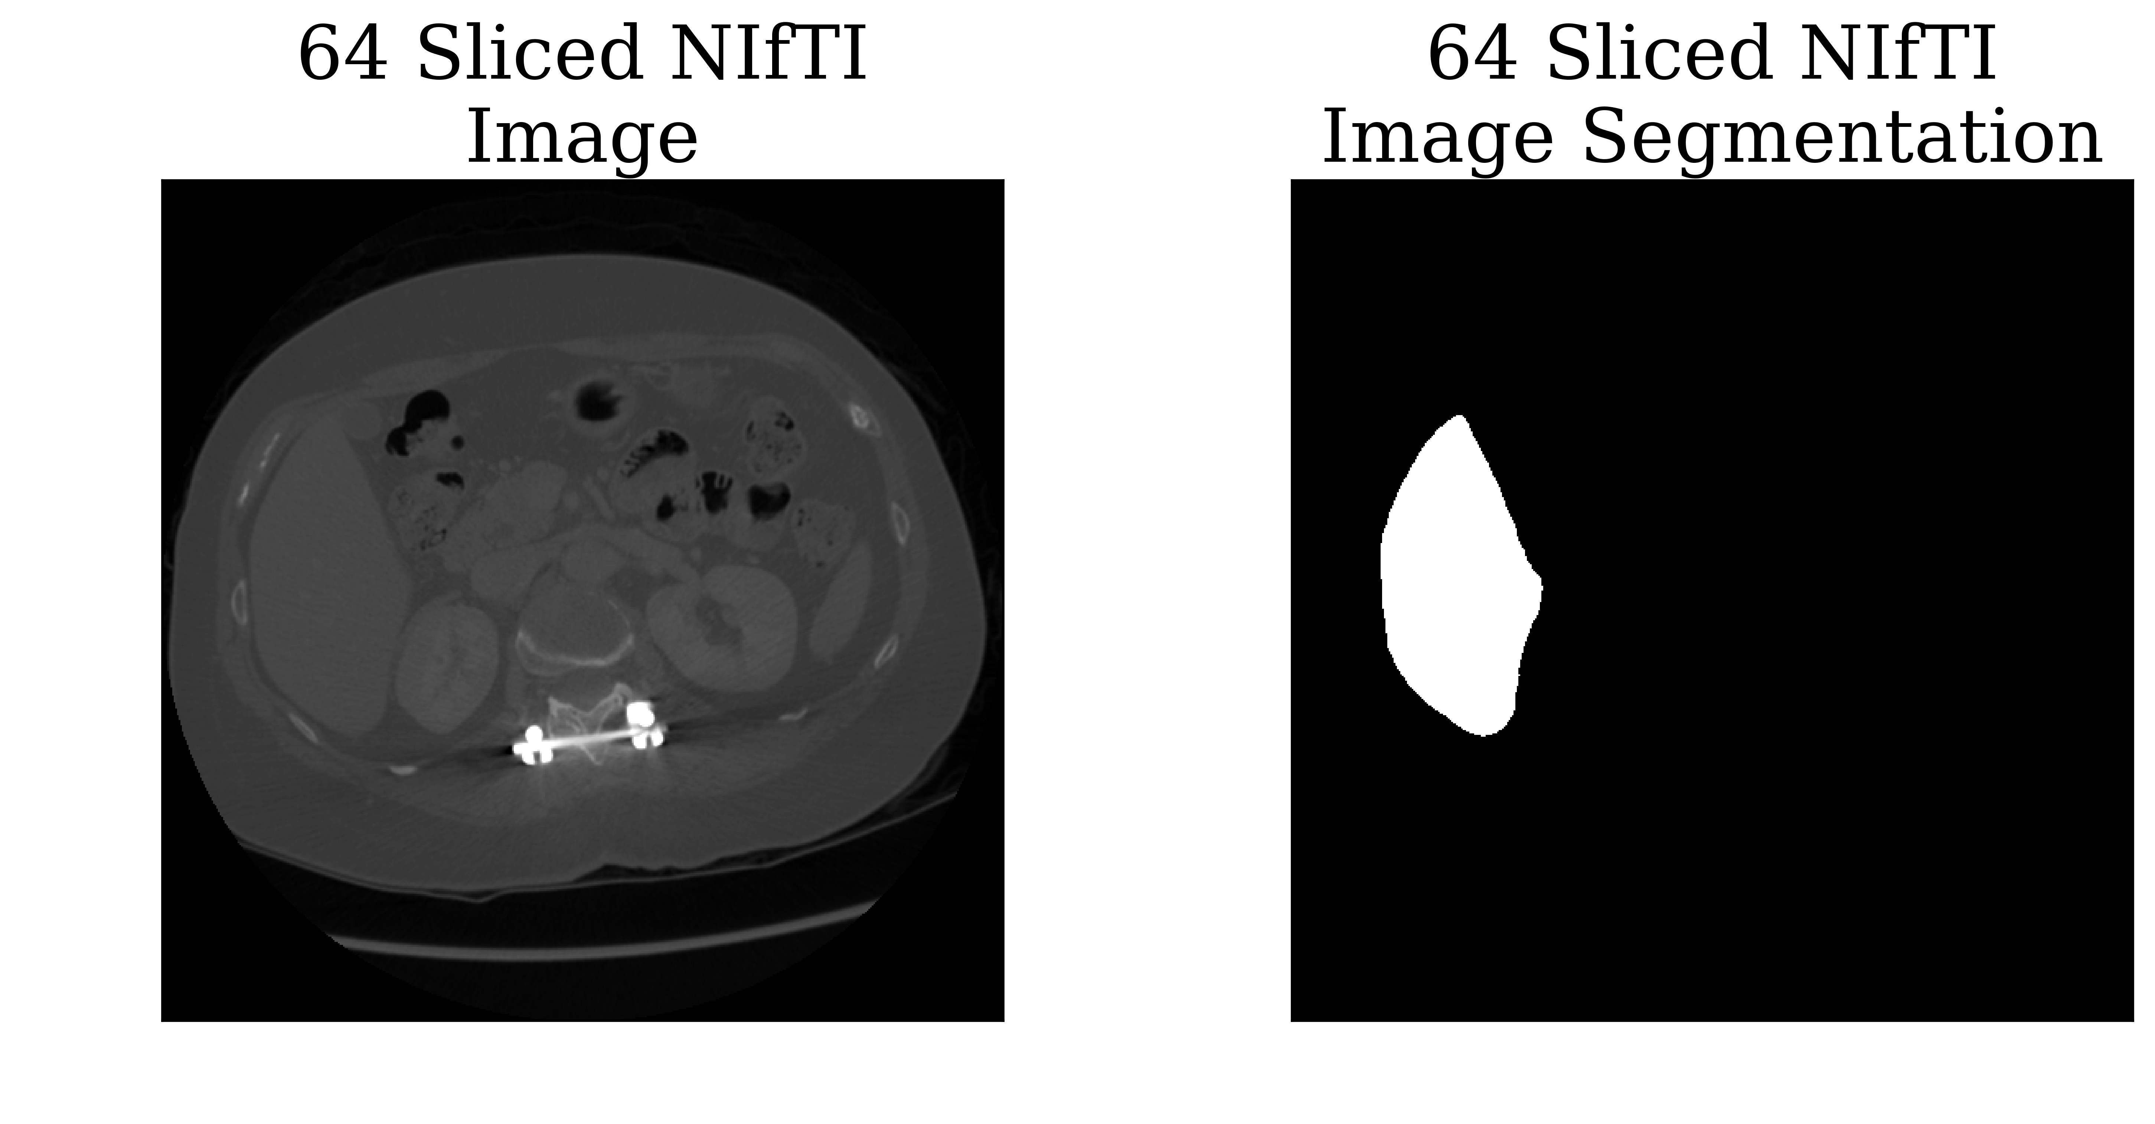
METHODOLOGY
DATA PREPARATION
DATASET DESCRIPTION
CT images in the dataset had uneven numbers of slices, so they were divided into subvolumes with equal numbers of slices for training
Subvolumes with 64 slices were chosen to balance computational efficiency and training speed
Some subvolumes had no liver representation, and therefore were discarded to prevent accuracy issues during training
Segmentation masks and CT volumes were split into train and test sets in a 4:1 ratio
MD Ashraf Hossain Ifty, Md. Salim Shahed Shajid
Electrical and Electronic Engineering,
Shahjalal University of Science and Technology, Sylhet-3114, Bangladesh
Implementation of Liver Segmentation from Computed Tomography (CT) Images using Deep Learning

Slide 8
METHODOLOGY
DATA PREPARATION
Why are medical images important?
For Diagnosis and treatment of diseases
Medical images are difficult to analyze
Medical images are not typical image files
3d medicals images are mostly in nifti (.nii / .nii.gz) format
The nifty files contain 2d slices called Dicom (.dcm) files
Introduction
image segmentation
the Deep learning Architecture
Monai framework
Methodology
Data collection
preparing training data
Training
results
7. Future work
A 64-SLICE NIfTI FILE WITH LIVER SEGMENTATION
MD Ashraf Hossain Ifty, Md. Salim Shahed Shajid
Implementation of Liver Segmentation from Computed Tomography (CT) Images using Deep Learning

Slide 9
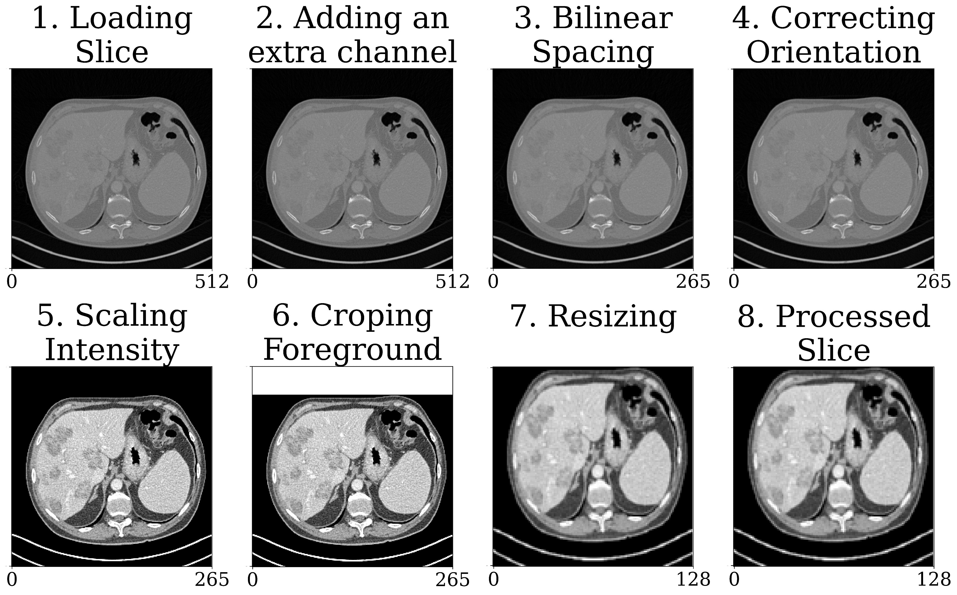
METHODOLOGY
DATA PREPARATION
Why are medical images important?
For Diagnosis and treatment of diseases
Medical images are difficult to analyze
Medical images are not typical image files
3d medicals images are mostly in nifti (.nii / .nii.gz) format
The nifty files contain 2d slices called Dicom (.dcm) files
Introduction
image segmentation
the Deep learning Architecture
Monai framework
Methodology
Data collection
preparing training data
Training
results
7. Future work
A 64-SLICE NIFTI FILE WITH NO LIVER SEGMENTATION
MD Ashraf Hossain Ifty, Md. Salim Shahed Shajid
Implementation of Liver Segmentation from Computed Tomography (CT) Images using Deep Learning

Slide 10
METHODOLOGY
DATA PREPROCESSING
TRAINING
THE EFFECTS OF EACH TRANSFORMATION
ON THE INPUT CT IMAGE
16x128x128
32x64x64
64x32x32
UP
128x16x16
UP
256x8x8
UP
UP
Implementation of Liver Segmentation from Computed Tomography (CT) Images using Deep Learning

Slide 11
Batch Norm
Conv2D+Stride
Batch Norm
Conv2D
PReLU
PReLU
+
METHODOLOGY
PREPARING TRAINING DATA
TRAINING
THE DEEP LEARNING ARCHITECTURE
16x128x128
UP
32x64x64
UP
RESIDUAL UNIT
64x32x32
UP
MD Ashraf Hossain Ifty, Md. Salim Shahed Shajid
128x16x16
UP
Electrical and Electronic Engineering,
Shahjalal University of Science and Technology, Sylhet-3114, Bangladesh
256x8x8
Implementation of Liver Segmentation from Computed Tomography (CT) Images using Deep Learning

Slide 12
METHODOLOGY
TRAINING
+
Batch Norm
Conv2D+Stride
Batch Norm
Conv2D
PReLU
PReLU
RESIDUAL UNIT
UPSAMPLE UNIT
Implementation of Liver Segmentation from Computed Tomography (CT) Images using Deep Learning
UP
UP
UP
UP
16x128x128
32x64x64
64x32x32
128x16x16
256x8x8

Slide 13
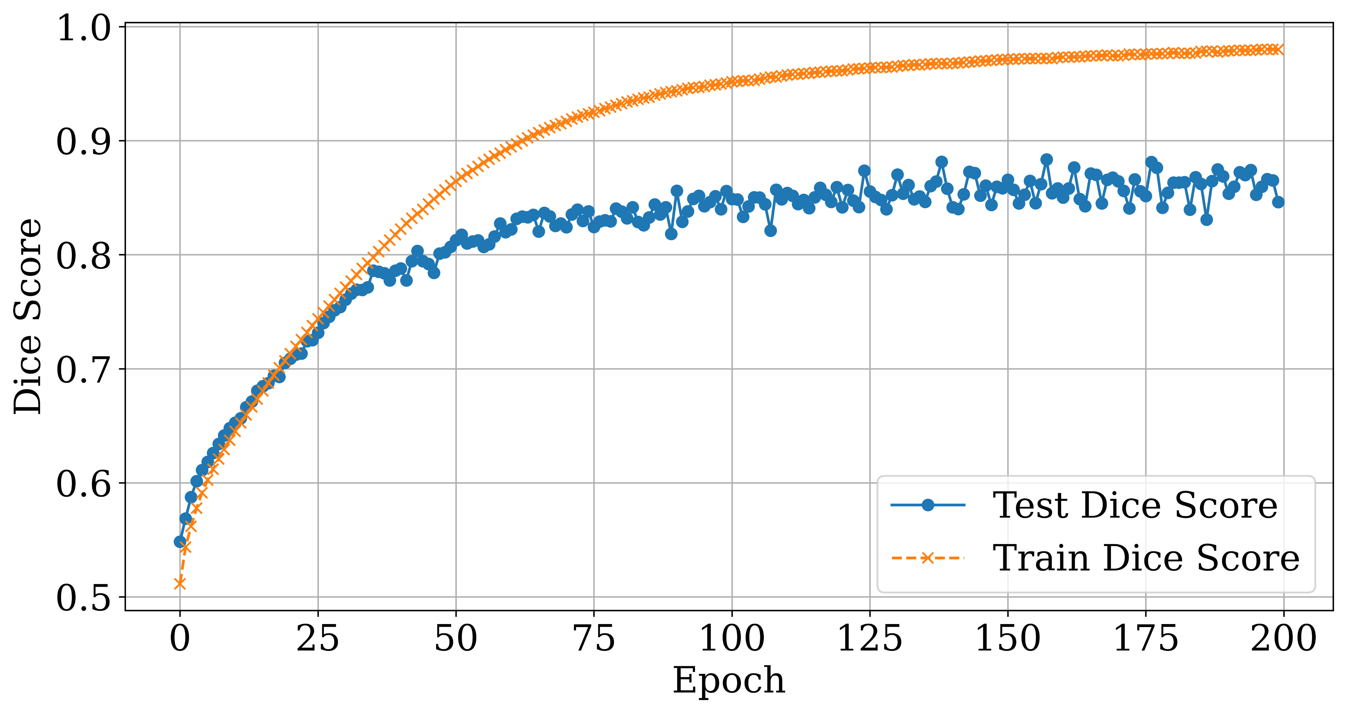
RESULTS
METHODOLOGY
TRAINING
+
Concat
ConvTrans2d+ Stride
PReLU
Batch Norm
Conv2D
UPSAMPLE UNIT
RESIDUAL UNIT
Implementation of Liver Segmentation from Computed Tomography (CT) Images using Deep Learning

Slide 14



RESULTS
TRAINING
METHODOLOGY
OVERVIEW
SUBGROUPS EACH
CONTAINING 64 IMAGES
+
NON-EMPTY
SUBGROUPS
Concat
ConvTrans2d+ Stride
PReLU
Batch Norm
Conv2D
DATABASE
SINGLE
.NII.GZ (NIFTI FILE)
UPSAMPLE UNIT
RESIDUAL UNIT
Implementation of Liver Segmentation from Computed Tomography (CT) Images using Deep Learning

Slide 15
RESULTS
TRAINING
METHODOLOGY
OVERVIEW
SUBGROUPS EACH
CONTAINING 64 IMAGES
NON-EMPTY
SUBGROUPS
TRAINING SET
+
COLLECTION OF
NON-EMPTY SUBGROUPS
DATABASE
SINGLE
.NII.GZ (NIFTI FILE)
Concat
ConvTrans2d+ Stride
PReLU
Batch Norm
Conv2D
UPSAMPLE UNIT
RESIDUAL UNIT
TESTING SET
Implementation of Liver Segmentation from Computed Tomography (CT) Images using Deep Learning

Slide 16

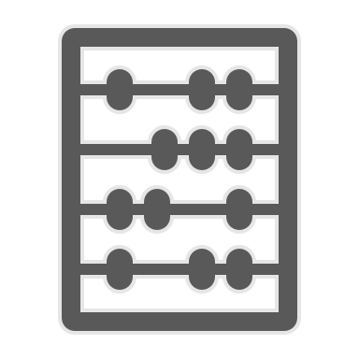
RESULTS
TRAINING
METHODOLOGY
OVERVIEW
SUBGROUPS EACH
CONTAINING 64 IMAGES
NON-EMPTY
SUBGROUPS
+
PREPROCESSING PIPELINE
TRAINING SET
DATABASE
SINGLE
.NII.GZ (NIFTI FILE)
COLLECTION OF
NON-EMPTY SUBGROUPS
Concat
ConvTrans2d+ Stride
PReLU
Batch Norm
Conv2D
UPSAMPLE UNIT
SINGLE
IMAGE
TENSOR
RESIDUAL UNIT
TESTING SET
Implementation of Liver Segmentation from Computed Tomography (CT) Images using Deep Learning

Slide 17
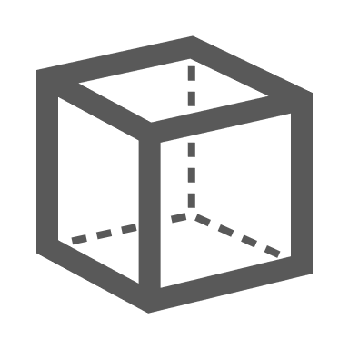
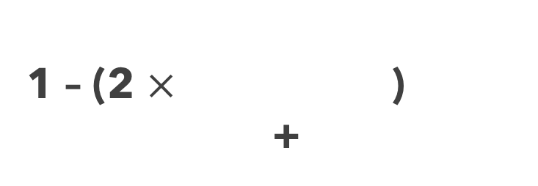
RESULTS
TRAINING
METHODOLOGY
OVERVIEW
SUBGROUPS EACH
CONTAINING 64 IMAGES
NON-EMPTY
SUBGROUPS
MODEL
+
TRAIN
TENSOR
TESTING MODEL’S PREDICTION
AGAINST TEST TENSOR
TRAINING SET
PREPROCESSING PIPELINE
DATABASE
SINGLE
.NII.GZ (NIFTI FILE)
COLLECTION OF
NON-EMPTY SUBGROUPS
Concat
ConvTrans2d+ Stride
PReLU
Batch Norm
Conv2D
UPSAMPLE UNIT
SINGLE
IMAGE
TENSOR
LOSS
CALCULATION
RESIDUAL UNIT
IMPROVING THE MODEL
BASED ON LOSS
1 – (2 $×$ )
+
TESTING SET
Implementation of Liver Segmentation from Computed Tomography (CT) Images using Deep Learning

Slide 18
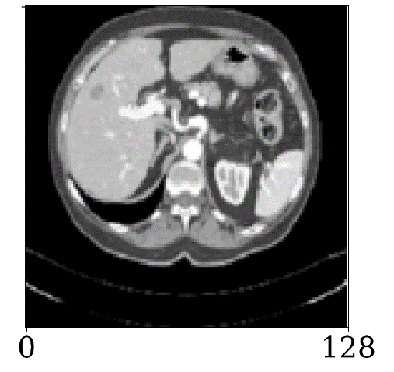
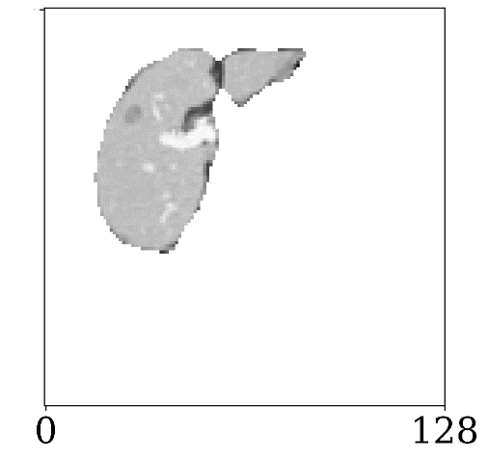
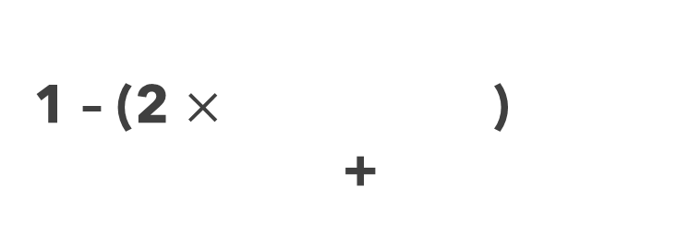
RESULTS
TRAINING
METHODOLOGY
OVERVIEW
MODEL
SUBGROUPS EACH
CONTAINING 64 IMAGES
NON-EMPTY
SUBGROUPS
+
TRAIN
TENSOR
TESTING MODEL’S PREDICTION
AGAINST TEST TENSOR
TRAINING SET
PREPROCESSING PIPELINE
DATABASE
PROCESSED
CT IMAGE
SINGLE
.NII.GZ (NIFTI FILE)
MODEL
SEGMENTATION
Concat
ConvTrans2d+ Stride
PReLU
Batch Norm
Conv2D
COLLECTION OF
NON-EMPTY SUBGROUPS
UPSAMPLE UNIT
SINGLE
IMAGE
LOSS
CALCULATION
TENSOR
RESIDUAL UNIT
IMPROVING THE MODEL
BASED ON LOSS
1 – (2 $×$ )
+
TESTING SET
Implementation of Liver Segmentation from Computed Tomography (CT) Images using Deep Learning

Slide 19
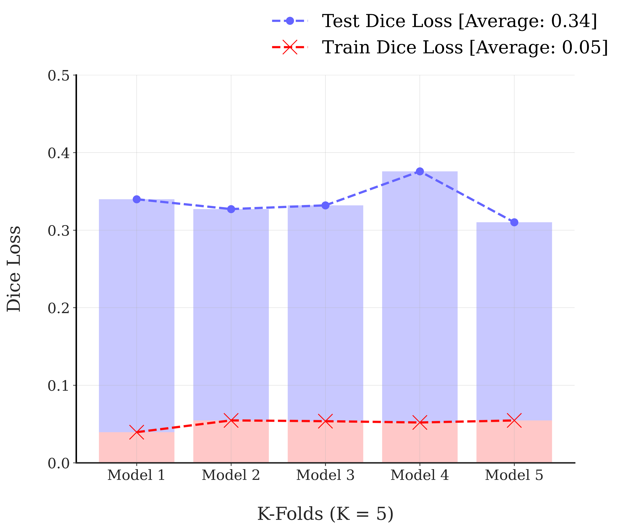
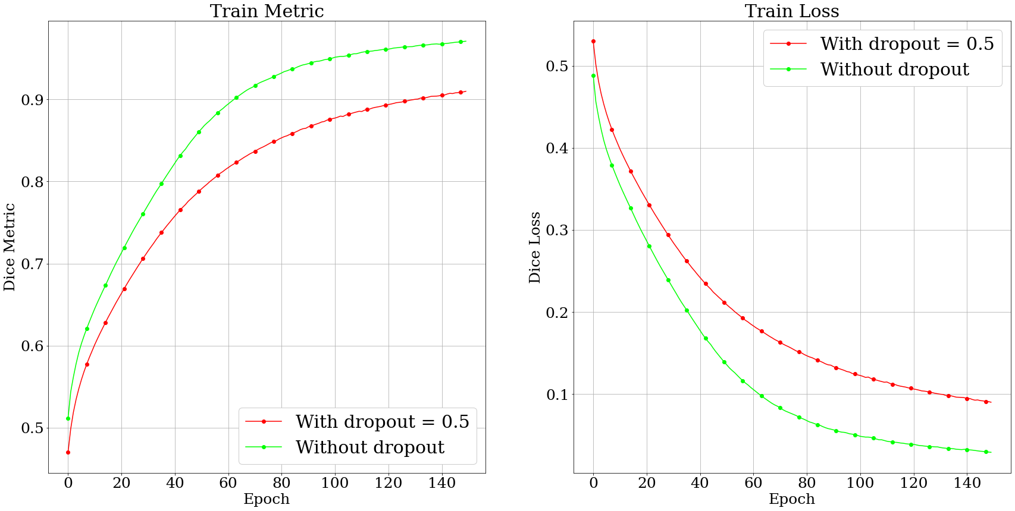
PARAMETER EVALUATION
DROPOUT EVALUATION
Implementation of Liver Segmentation from Computed Tomography (CT) Images using Deep Learning

Slide 20
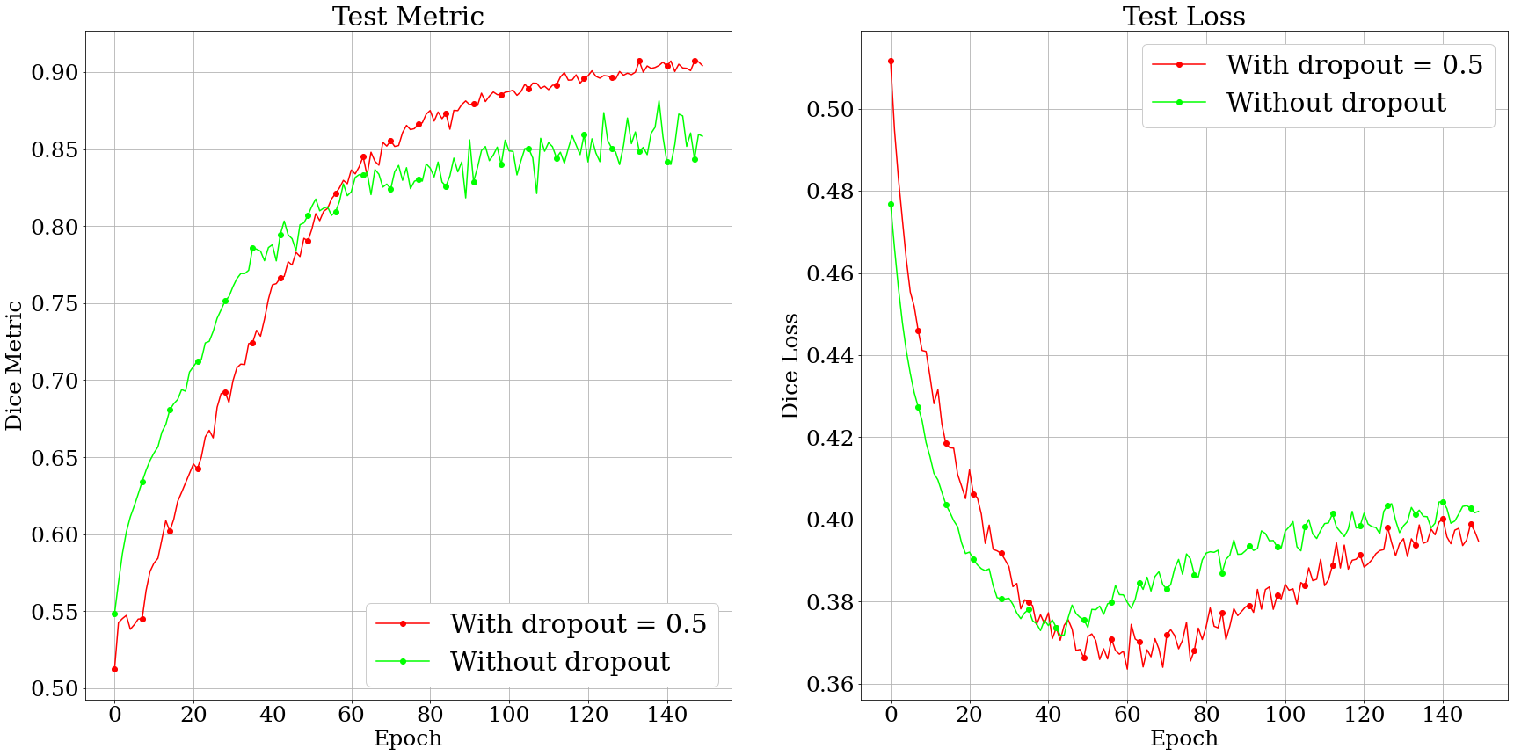
PARAMETER EVALUATION
DROPOUT EVALUATION
Implementation of Liver Segmentation from Computed Tomography (CT) Images using Deep Learning

Slide 21
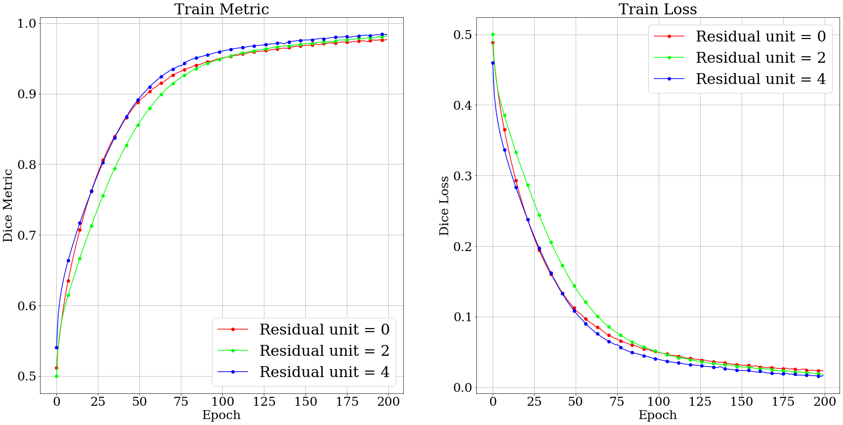
PARAMETER EVALUATION
RESIDUAL UNIT EVALUATION
Implementation of Liver Segmentation from Computed Tomography (CT) Images using Deep Learning

Slide 22
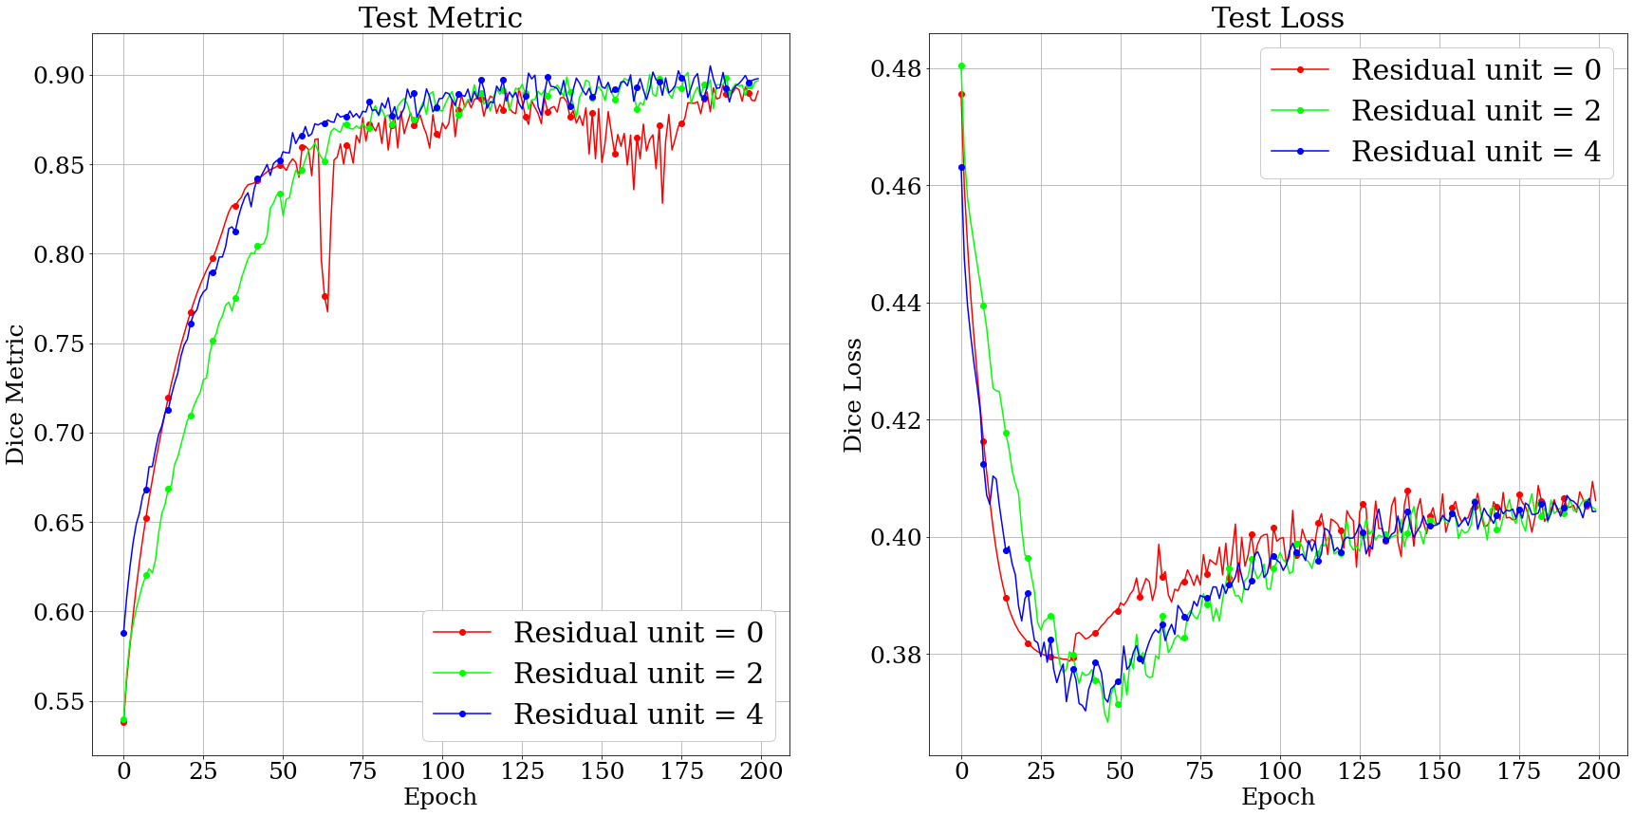
PARAMETER EVALUATION
RESIDUAL UNIT EVALUATION
Implementation of Liver Segmentation from Computed Tomography (CT) Images using Deep Learning

Slide 23
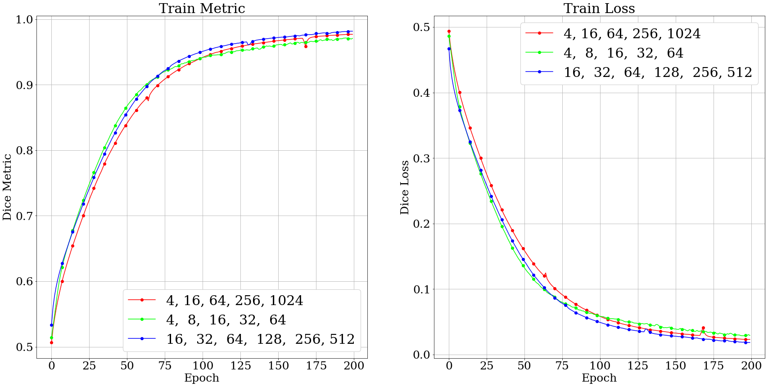
PARAMETER EVALUATION
CHANNEL LENGTH EVALUATION
Implementation of Liver Segmentation from Computed Tomography (CT) Images using Deep Learning

Slide 24
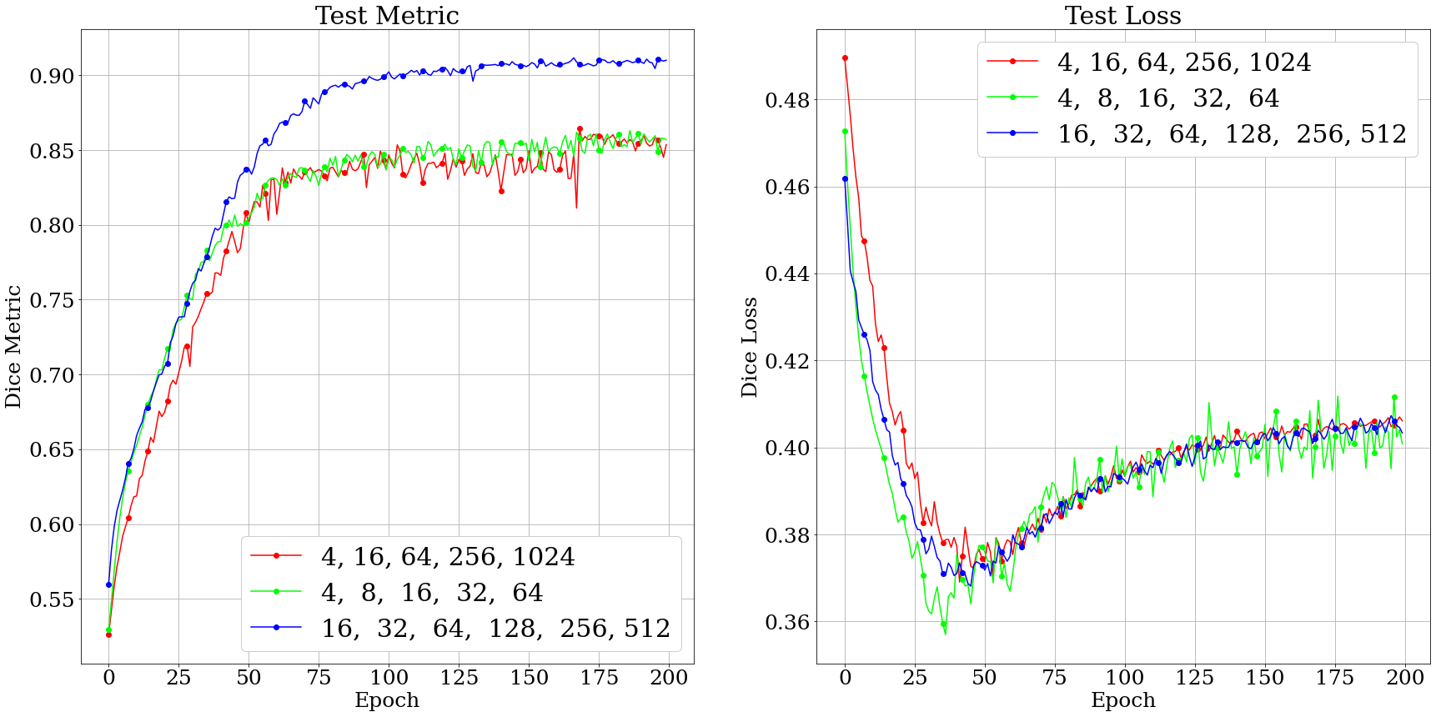
PARAMETER EVALUATION
CHANNEL LENGTH EVALUATION
Implementation of Liver Segmentation from Computed Tomography (CT) Images using Deep Learning

Slide 25
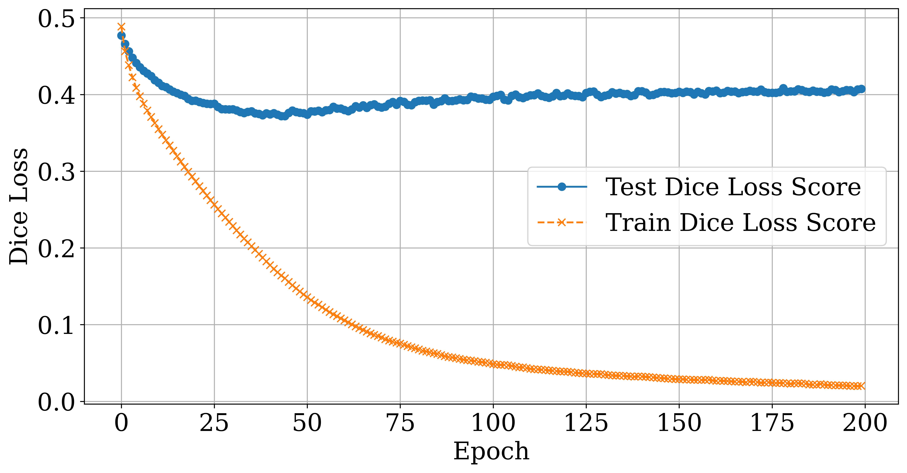
METHODOLOGY
RESULTS
TRAINING
Residual unit = 2
Channel length = (16, 32, 64, 128, 256)
Dropout = 0
+
Concat
ConvTrans2d+ Stride
PReLU
Batch Norm
Conv2D
UPSAMPLE UNIT
Electrical and Electronic Engineering,
Shahjalal University of Science and Technology, Sylhet-3114, Bangladesh
Implementation of Liver Segmentation from Computed Tomography (CT) Images using Deep Learning

Slide 26
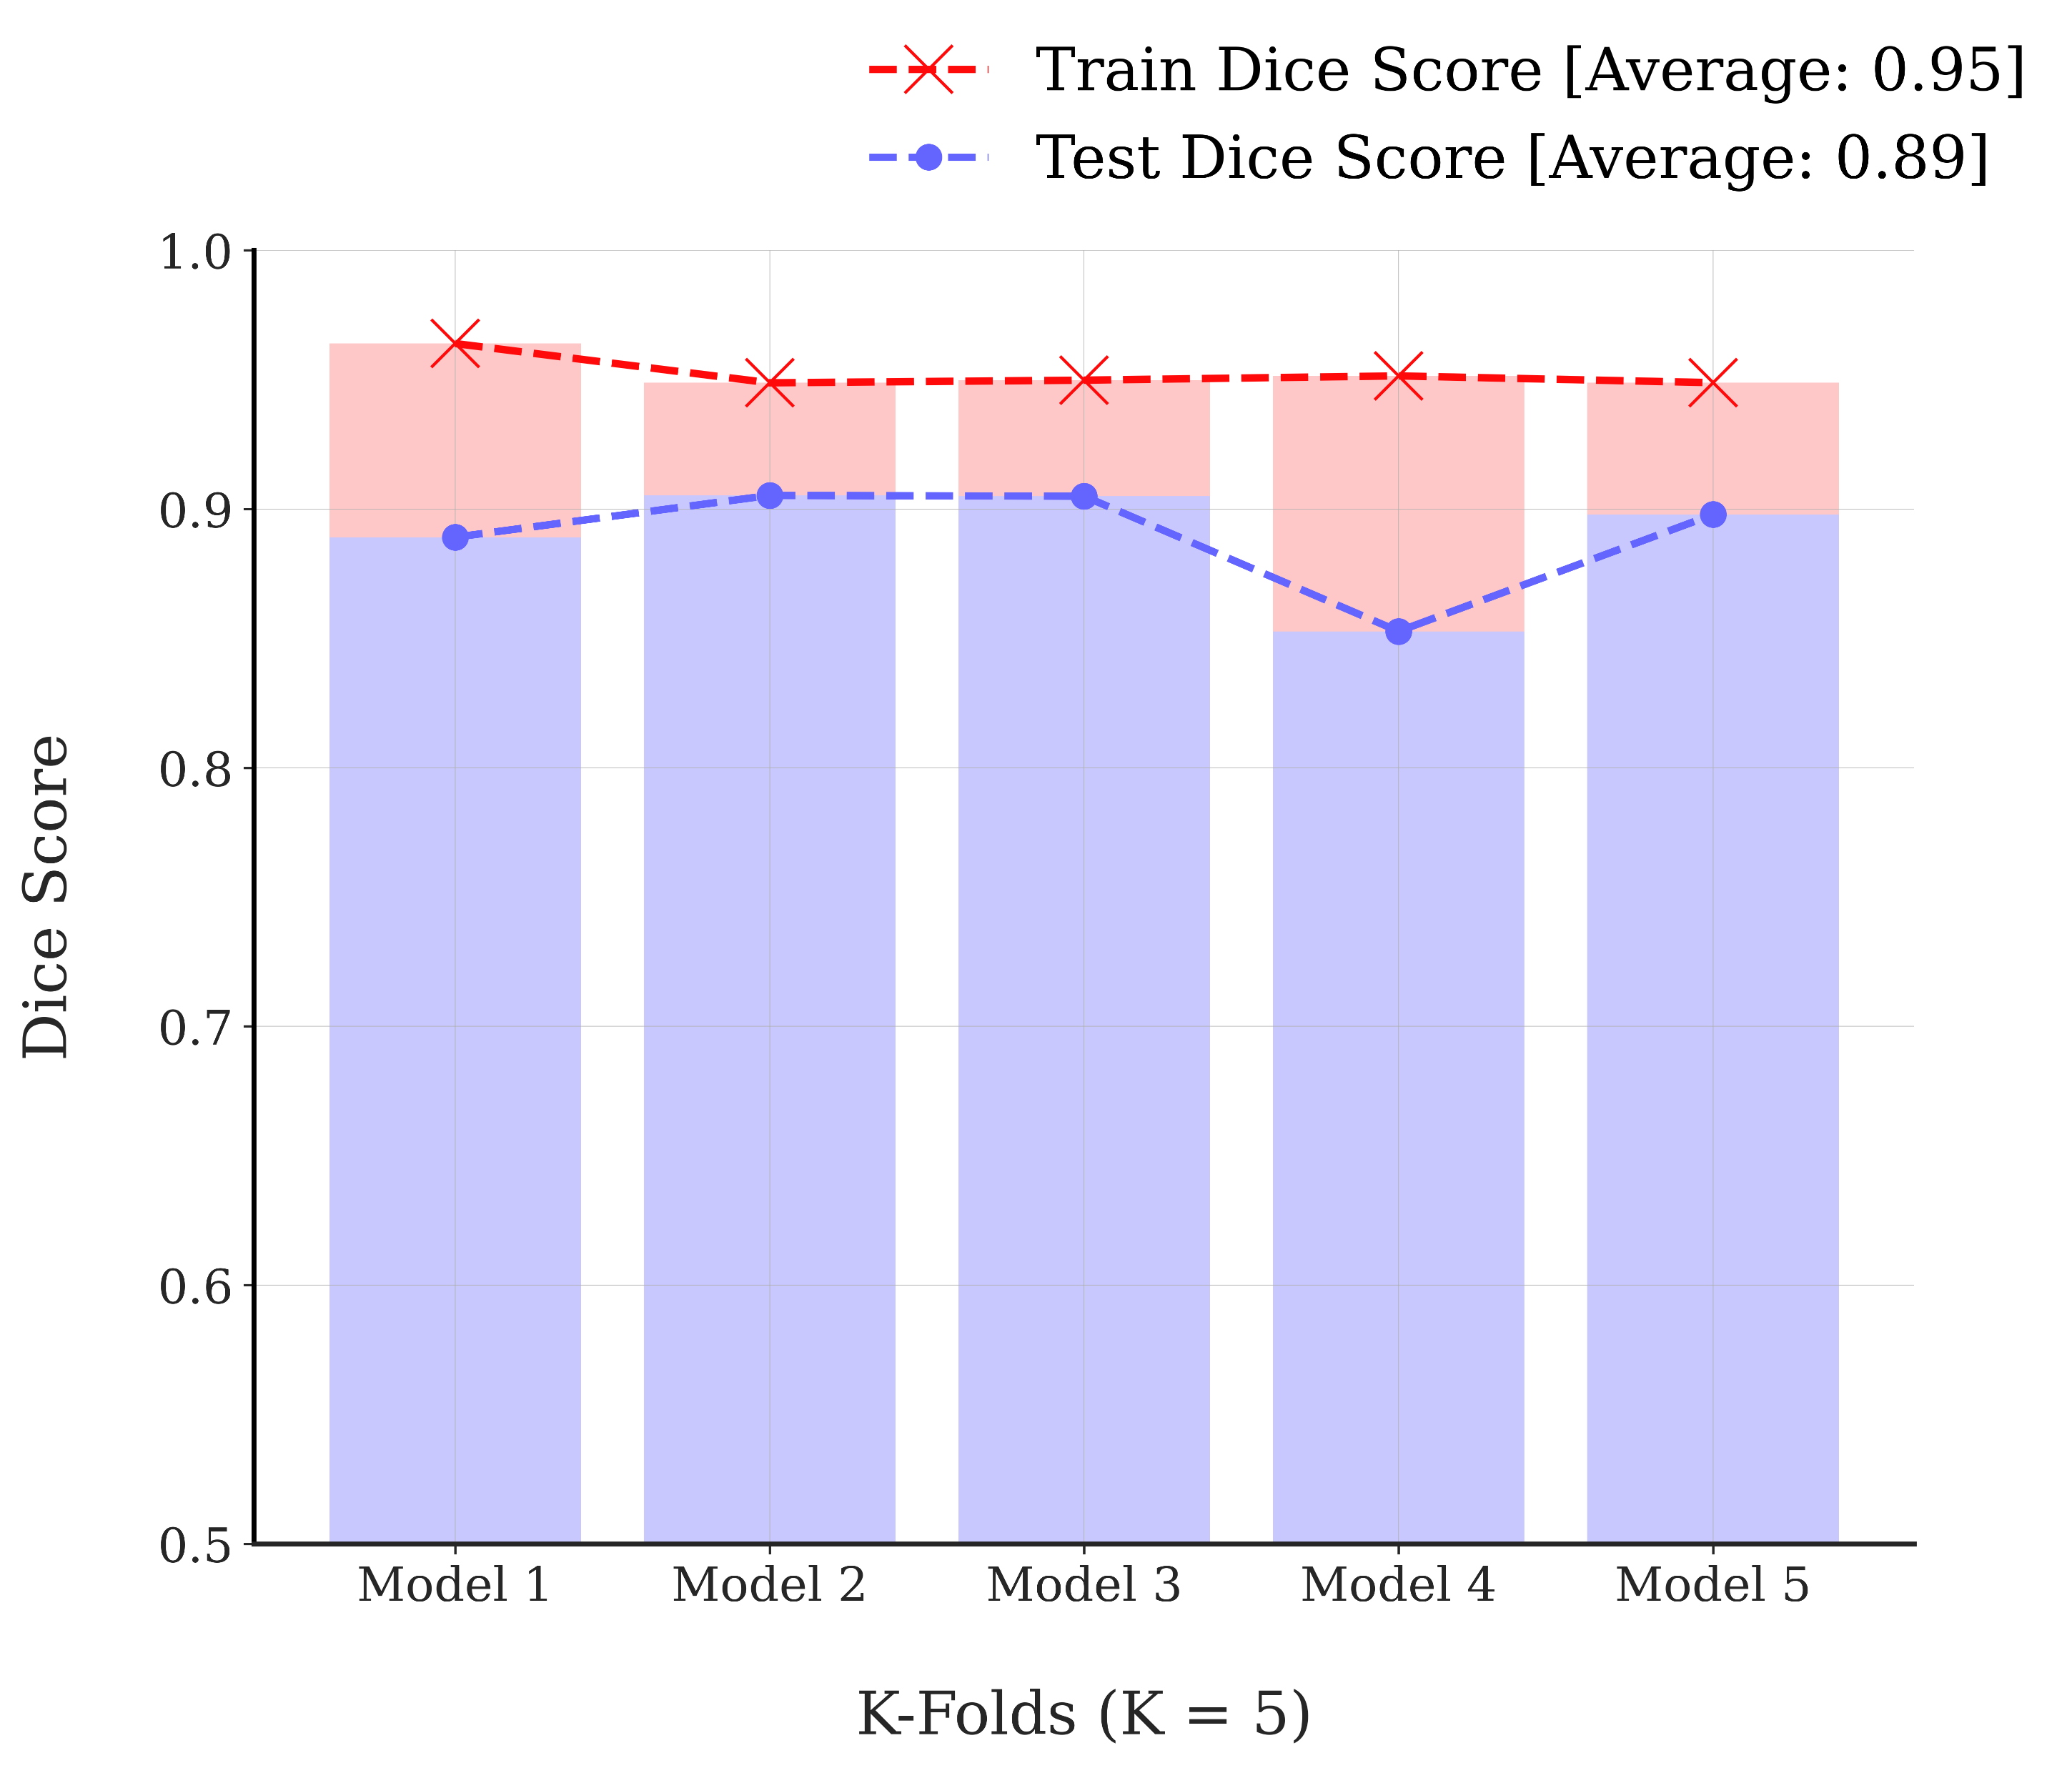
RESULTS
Residual unit = 2
Channel length = (16, 32, 64, 128, 256)
Dropout = 0
Implementation of Liver Segmentation from Computed Tomography (CT) Images using Deep Learning

Slide 27
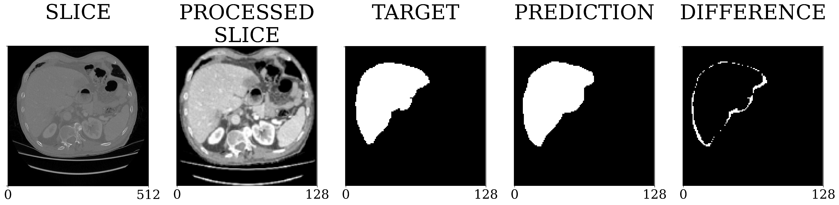
RESULTS
RESULTS
K-FOLD CROSS VALIDATION
TESTING MODEL’S PREDICTION
OVER ORIGINAL SEGMENTATION
(WHEN THE LIVER IS EASY TO LOCATE)
Implementation of Liver Segmentation from Computed Tomography (CT) Images using Deep Learning

Slide 28
RESULTS
METHODOLOGY
TRAINING
IMAGE SEGMENTATION
TESTING MODEL’S PREDICTION
OVER ORIGINAL SEGMENTATION
(WHEN THE LIVER IS HARD TO LOCATE)
TESTING MODEL’S PREDICTION
OVER ORIGINAL SEGMENTATION
(WHEN THE LIVER IS EASY TO LOCATE)
Electrical and Electronic Engineering,
Shahjalal University of Science and Technology, Sylhet-3114, Bangladesh
Implementation of Liver Segmentation from Computed Tomography (CT) Images using Deep Learning

Slide 29
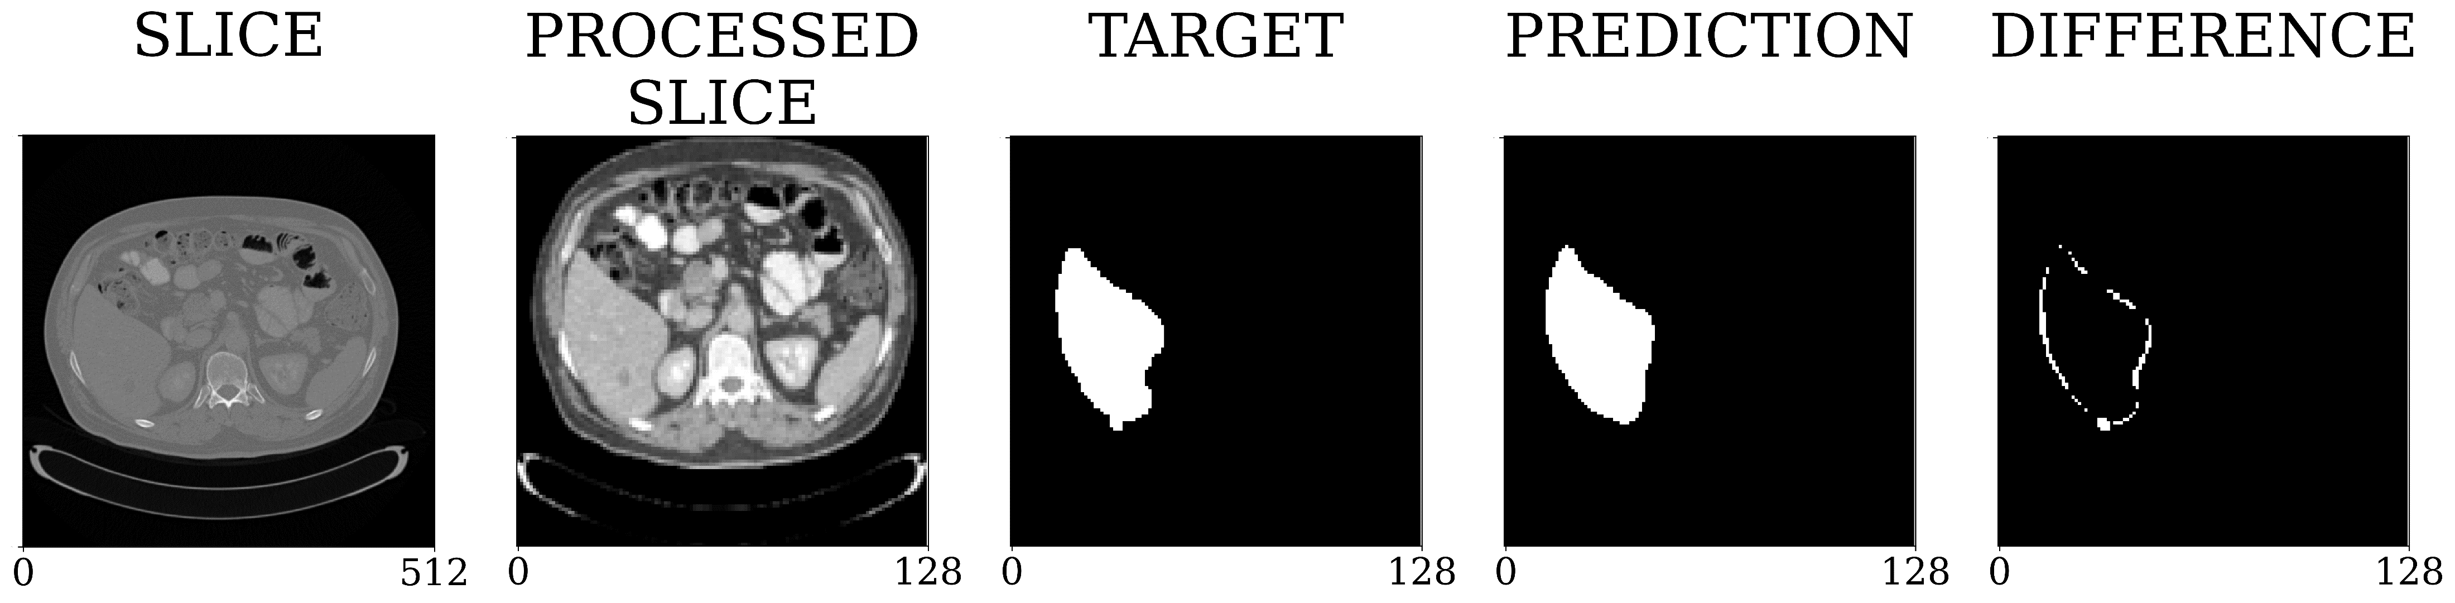
RESULTS
TESTING MODEL’S PREDICTION
OVER ORIGINAL SEGMENTATION
(WHEN THE LIVER IS EASY TO LOCATE)
TESTING MODEL’S PREDICTION
OVER ORIGINAL SEGMENTATION
(WHEN THE LIVER IS HARD TO LOCATE)
MODEL’S PREDICTED SEGMENTATION
OVER UNSEEN MEDICAL IMAGES
(WHEN THE LIVER IS EASY TO LOCATE)
Implementation of Liver Segmentation from Computed Tomography (CT) Images using Deep Learning

Slide 30
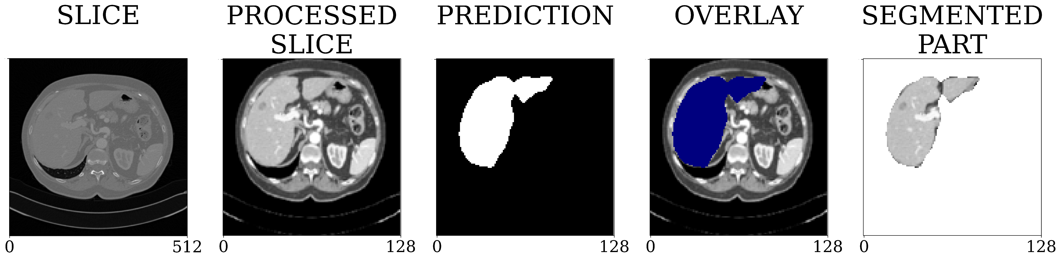
RESULTS
MODEL’S PREDICTED SEGMENTATION
OVER UNSEEN MEDICAL IMAGES
(WHEN THE LIVER IS HARD TO LOCATE)
MODEL’S PREDICTED SEGMENTATION
OVER UNSEEN MEDICAL IMAGES
(WHEN THE LIVER IS EASY TO LOCATE)
TESTING MODEL’S PREDICTION
OVER ORIGINAL SEGMENTATION
(WHEN THE LIVER IS HARD TO LOCATE)
Implementation of Liver Segmentation from Computed Tomography (CT) Images using Deep Learning

Slide 31
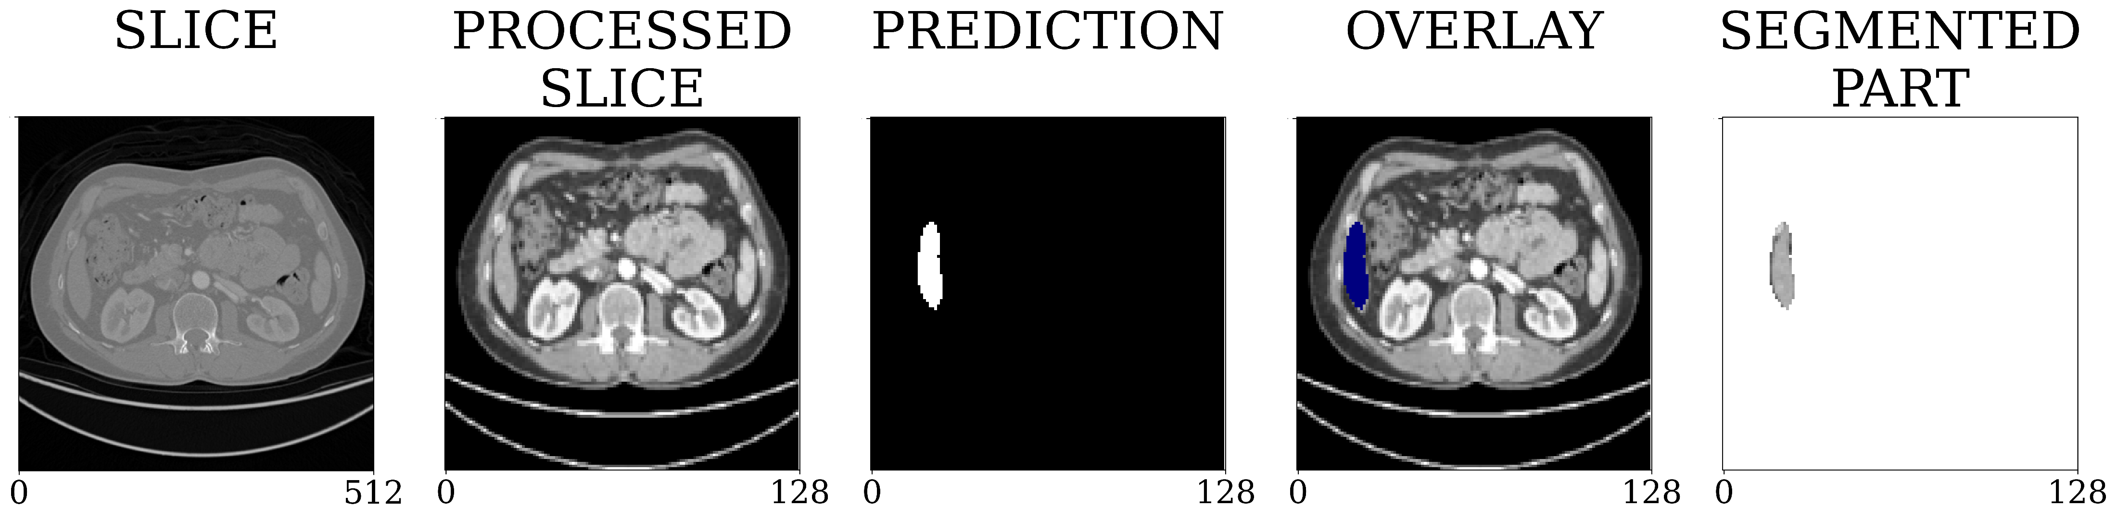
CONCLUSIONS AND FUTURE WORKS
RESULTS
MODEL’S PREDICTED SEGMENTATION
OVER UNSEEN MEDICAL IMAGES
(WHEN THE LIVER IS EASY TO LOCATE)
MODEL’S PREDICTED SEGMENTATION
OVER UNSEEN MEDICAL IMAGES
(WHEN THE LIVER IS HARD TO LOCATE)
Implementation of Liver Segmentation from Computed Tomography (CT) Images using Deep Learning

Slide 32
CONCLUSIONS AND FUTURE WORKS
RESULTS
This research used residual U-net to automatically segment liver from CT scans
Modifications to classic U-net architecture and effective training led to accurate results
Model performed well on unseen CT images, but hyper-parameter tuning, and transfer learning can be explored to increase precision
Insufficient amount of data limited model's accuracy; data augmentation strategies will be investigated
Considering the implementation of a model that can automatically extract and segment other organs from CT images.
MODEL’S PREDICTED SEGMENTATION
OVER UNSEEN MEDICAL IMAGES
(WHEN THE LIVER IS HARD TO LOCATE)
Implementation of Liver Segmentation from Computed Tomography (CT) Images using Deep Learning
THANK YOU

Slide 33

FUTURE WORK
REFERENCES
CONCLUSIONS AND FUTURE WORKS
[1] A. Jemal, F. Bray, M. M. Center, J. Ferlay, E. Ward, and D. Forman, “Global cancer statistics,” CA: A Cancer Journal for Clinicians, vol. 61, no. 2, pp. 69–90, 2011. [2] T. Heimann et al., ”Comparison and Evaluation of Methods for Liver Segmentation From CT Datasets,” in IEEE Transactions on Medical Imaging, vol. 28, no. 8, pp. 1251-1265, Aug. 2009, doi: 10.1109/TMI.2009.2013851. [3] P. F. Christ, M. E. Elshaer, F. Ettlinger, S. Tatavarty, M. Bickel, P. Bilic, M. Rempfler, M. Armbruster, F. Hofmann, M. D’Anastasi, W. H. Sommer, S.-A. Ahmadi, and B. H. Menze, “Automatic liver and lesion segmentation in CT using cascaded fully convolutional neural networks and 3D conditional random fields,” Medical Image Computing and Computer-Assisted Intervention – MICCAI 2016, pp. 415–423, 2016. [4] L. E. Hann, C. B. Winston, K. T. Brown, and T. Akhurst, “Diagnostic Imaging Approaches and relationship to hepatobiliary cancer staging and therapy,” Seminars in Surgical Oncology, vol. 19, no. 2, pp. 94–115, 2000.
[5] P. Campadelli, E. Casiraghi, and A. Esposito, “Liver segmentation from computed tomography scans: A survey and a new algorithm,” Artificial Intelligence in Medicine, vol. 45, no. 2-3, pp. 185–196, 2009. [6] M. H. Hesamian, W. Jia, X. He, and P. Kennedy, “Deep learning tech- niques for medical image segmentation: Achievements and challenges,” Journal of Digital Imaging, vol. 32, no. 4, pp. 582–596, 2019. [7] P. Bilic, P. F. Christ, E. Vorontsov, G. Chlebus, H. Chen, Q. Dou, C.-W. Fu, X. Han, P.-A. Heng, J. Hesser, et al., “The liver tumor segmentation benchmark (lits),” arXiv preprint arXiv:1901.04056, 2019. [8] O. Ronneberger, P. Fischer, and T. Brox. ”U-Net: Convolutional Net- works for Biomedical Image Segmentation.” In Proceedings of the
International Conference on Medical Image Computing and Computer- Assisted Intervention, 2015, pp. 234-241. [9] MONAI Consortium, MONAI: Medical Open Network for AI. Zenodo, 2022. doi: 10.5281/ZENODO.4323058. [10] C. H. Sudre, W. Li, T. Vercauteren, S. Ourselin, and M. Jorge Cardoso, “Generalised dice overlap as a deep learning loss function for highly unbalanced segmentations,” Deep Learning in Medical Image Analysis and Multimodal Learning for Clinical Decision Support, pp. 240–248, 2017. [11] L. R. Dice, “Measures of the amount of ecologic association between species,” Ecology, vol. 26, no. 3, pp. 297–302, 1945. [12] K. He, X. Zhang, S. Ren, and J. Sun. ”Identity Mappings in Deep Residual Networks.” CoRR, vol. abs/1603.05027, 2016. [13] J. Zhou, Y. Chen, Y. Wei, Y. Liu, and D. Zhang. ”Road Extraction by Deep Residual U-Net.” In Proceedings of the International Conference on Intelligent Transportation Systems, 2019, pp. 2551-2556. [14] K. He, X. Zhang, S. Ren, and J. Sun, “Delving deep into rectifiers: surpassing human-level performance on imagenet classification,” in Proceedings of the IEEE International Conference on Computer Vision, 2015, pp. 1026–1034. [15] I. L. Arpit, D. Bhatnagar, A. Kumar, V. V. Phoha, ”Batch Normalization: Accelerating Deep Network Training by Reducing Internal Covariate Shift,” arXiv preprint arXiv:1502.03167, 2015
Add models that are trained on Other organs and Detect organs Automatically
Hyperparameter tuning
Increase model accuracy with More training data via data augmentation
Comparative study between different deep learning segmentation models
IMAGE SEGMENTATION
Introduction
image segmentation
the Deep learning Architecture
Monai framework
Methodology
Data collection
preparing training data
Training
results
7. Future work
MODEL’S PREDICTED SEGMENTATION
OVER UNSEEN MEDICAL IMAGES
Liver
THANK YOU
MD Ashraf Hossain Ifty, Md. Salim Shahed Shajid
Electrical and Electronic Engineering,
Shahjalal University of Science and Technology, Sylhet-3114, Bangladesh
Implementation of Liver Segmentation from Computed Tomography (CT) Images using Deep Learning

Slide 34
REFERENCES
[1] A. Jemal, F. Bray, M. M. Center, J. Ferlay, E. Ward, and D. Forman, “Global cancer statistics,” CA: A Cancer Journal for Clinicians, vol. 61, no. 2, pp. 69–90, 2011. [2] T. Heimann et al., ”Comparison and Evaluation of Methods for Liver Segmentation From CT Datasets,” in IEEE Transactions on Medical Imaging, vol. 28, no. 8, pp. 1251-1265, Aug. 2009, doi: 10.1109/TMI.2009.2013851. [3] P. F. Christ, M. E. Elshaer, F. Ettlinger, S. Tatavarty, M. Bickel, P. Bilic, M. Rempfler, M. Armbruster, F. Hofmann, M. D’Anastasi, W. H. Sommer, S.-A. Ahmadi, and B. H. Menze, “Automatic liver and lesion segmentation in CT using cascaded fully convolutional neural networks and 3D conditional random fields,” Medical Image Computing and Computer-Assisted Intervention – MICCAI 2016, pp. 415–423, 2016. [4] L. E. Hann, C. B. Winston, K. T. Brown, and T. Akhurst, “Diagnostic Imaging Approaches and relationship to hepatobiliary cancer staging and therapy,” Seminars in Surgical Oncology, vol. 19, no. 2, pp. 94–115, 2000.
[5] P. Campadelli, E. Casiraghi, and A. Esposito, “Liver segmentation from computed tomography scans: A survey and a new algorithm,” Artificial Intelligence in Medicine, vol. 45, no. 2-3, pp. 185–196, 2009. [6] M. H. Hesamian, W. Jia, X. He, and P. Kennedy, “Deep learning tech- niques for medical image segmentation: Achievements and challenges,” Journal of Digital Imaging, vol. 32, no. 4, pp. 582–596, 2019. [7] P. Bilic, P. F. Christ, E. Vorontsov, G. Chlebus, H. Chen, Q. Dou, C.-W. Fu, X. Han, P.-A. Heng, J. Hesser, et al., “The liver tumor segmentation benchmark (lits),” arXiv preprint arXiv:1901.04056, 2019. [8] O. Ronneberger, P. Fischer, and T. Brox. ”U-Net: Convolutional Net- works for Biomedical Image Segmentation.” In Proceedings of the
International Conference on Medical Image Computing and Computer- Assisted Intervention, 2015, pp. 234-241. [9] MONAI Consortium, MONAI: Medical Open Network for AI. Zenodo, 2022. doi: 10.5281/ZENODO.4323058. [10] C. H. Sudre, W. Li, T. Vercauteren, S. Ourselin, and M. Jorge Cardoso, “Generalised dice overlap as a deep learning loss function for highly unbalanced segmentations,” Deep Learning in Medical Image Analysis and Multimodal Learning for Clinical Decision Support, pp. 240–248, 2017. [11] L. R. Dice, “Measures of the amount of ecologic association between species,” Ecology, vol. 26, no. 3, pp. 297–302, 1945. [12] K. He, X. Zhang, S. Ren, and J. Sun. ”Identity Mappings in Deep Residual Networks.” CoRR, vol. abs/1603.05027, 2016. [13] J. Zhou, Y. Chen, Y. Wei, Y. Liu, and D. Zhang. ”Road Extraction by Deep Residual U-Net.” In Proceedings of the International Conference on Intelligent Transportation Systems, 2019, pp. 2551-2556. [14] K. He, X. Zhang, S. Ren, and J. Sun, “Delving deep into rectifiers: surpassing human-level performance on imagenet classification,” in Proceedings of the IEEE International Conference on Computer Vision, 2015, pp. 1026–1034. [15] I. L. Arpit, D. Bhatnagar, A. Kumar, V. V. Phoha, ”Batch Normalization: Accelerating Deep Network Training by Reducing Internal Covariate Shift,” arXiv preprint arXiv:1502.03167, 2015
PAPER ID: [406]
THANK YOU
MD Ashraf Hossain Ifty, Md. Salim Shahed Shajid
MD Ashraf Hossain Ifty, Md. Salim Shahed Shajid
Electrical and Electronic Engineering,
Shahjalal University of Science and Technology, Sylhet-3114, Bangladesh
Electrical and Electronic Engineering,
Shahjalal University of Science and Technology, Sylhet-3114, Bangladesh
Implementation of Liver Segmentation from Computed Tomography (CT) Images using Deep Learning

Slide 35
A THESIS PRESENTATION ON
REFERENCES
Implementation of Liver Segmentation from Computed Tomography (CT) Images using Deep Learning
by
MD Ashraf Hossain Ifty (2017338042), and
Md. Salim Shahed Shajid (2017338016)
Thesis group: 3
Supervised by
Dr. Md Rasedujjaman
Electrical and Electronic Engineering,
Shahjalal University of Science and Technology, Sylhet-3114, Bangladesh

